Slide 1
Computational Complexity
计算复杂性
Lecture 14-15 IP, ZKP and PCP

Slide 2
IP: Interactive Proofs
Interactive proofs
ZKP
Probabilistically Checkable Proof (PCP)

Slide 3
Proof systems
For a set S, goal is to prove x ∈ S
Proof system for S is defined by a verification algorithm V
  completeness: x ∈ S ⇒  proof, V accepts (x, proof)
    true assertions have proofs
  soundness: x ∉ S ⇒  proof*, V rejects (x, proof*)
    false assertions have no proofs
  efficiency:  x, proof, the machine running V(x, proof) is efficient:
    runs in polynomial time in |x|

Slide 4
Proof Systems Back to NP
In order to understand the notion of Proof Systems, let us observe NP again.
In a way, the complexity class we will define and discuss later is a probabilistic analog of NP.
The problem in NP are those whose members all have short certificates of membership, which can be easily verified.

Slide 5
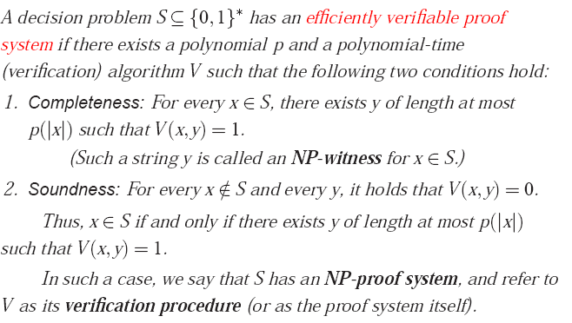
We denote by N P the class of decision problems that have efficiently verifiable proof systems.

Slide 6
Proof Systems Back to NP
We can view this as follows:
  There is a mighty powerful Prover.
  The Prover needs to convince a Verifier that the input is indeed a member of the set.
  So it sends the Verifier a short (polynomial) certificate.
  The Verifier has limited resources: the verification of the certificate cannot take more than polynomial time.

Slide 7


Proof Systems Back to NP
We will demonstrate this process for 3SAT:
We would like to check the membership of a given formula:
The verifier simply needs to check the truth value of the formula under the assignment it received in order to find out whether the prover was right. This merely takes polynomial time.
(x∨y∨z’)∧(x’∨y’)∧z’
polynomial in the number of variables
ρ(x)=false
ρ(y)=true
ρ(z)=false
The prover must convince the verifier this formula is satisfiable, so it sends it an assignment, which supposedly satisfies the formula. It is not difficult for the mighty prover to find such, if such exists.

Slide 8
Proof Systems Requirements
Let us specifically define the properties of a Proof System:
  The verifier’s strategy is efficient
  Correctness Requirements:
      Completeness: For a true assertion, there is a convincing proof strategy.
      Soundness: For a false assertion, no proof strategy exists.
The proof system we presented for 3SAT satisfy these properties.

Slide 9
Classical Proofs
Recall: N P the class of decision problems that have efficiently verifiable proof systems
NP is the set of problems with classical proof systems
We wish to extend the notion.

Slide 10
Interactive Proofs
Two new ingredients:
  Randomness: verifier tosses coins
    Should error with some small probability
  Interaction: rather than simply “reading” the proof, verifier interacts with prover
    Is the prover another TM?
Framework captures the classical NP proof systems::
  prover sends proof.
  verifier runs algorithm
  No use of randomness

Slide 11
Interactive Proofs
Interactive proof system for S is an interactive protocol (P, V)
Random tape
Common input: x
Prover
Verifier
New issue: who knows the random tape
. . .
# rounds and length of messages is poly(|x|)
New resources:
# of rounds
Length of message
accept/reject

Slide 12
Interactive Proofs
Definition: an interactive proof system for S is an interactive protocol (P, V)
  completeness: x ∈ S:
  Pr[V accepts in an execution of (P, V)(x)] ≥ 2/3
  soundness: x ∉ S ⇒  P*
  Pr[V accepts in an execution of (P*, V)(x)] ≤ 1/3
  efficiency: V is PPT machine
Perfect Completeness: V accepts with Prob 1

Slide 13
Interactive Proofs
An Interactive Proof System for S is a two-party game between a verifier and a prover that interact on a common input in a way satisfying the following properties:
  The verifier’s strategy is a probabilistic polynomial-time procedure.
  Correctness requirements:
      Completeness: There exists a prover strategy P, such that for every x∈S, when interacting on a common input x, the prover P convinces the verifier with probability at least 2/3.
      Soundness: For every x∉S, when interacting on the common input x, any prover strategy P* convinces the verifier with probability at most 1/3.

Slide 14
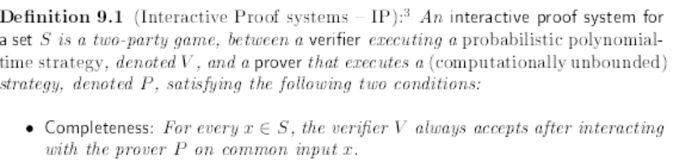

Can we reduce the error to any ε?

Slide 15
Error Reduction
If we execute the protocol sequentially ℓ times let
  I_{j} =1 if jth run is correct and 0 otherwise
    The I_{j}’s are not necessarily independent of each other but, since can tolerate any prover*
  Pr[I_{j} =1 | any execution history] ¸ 2/3
  If we compare to ℓ independent coins with probability 2/3 where we take majority of answers
    For any prover* the interactive proof stochastically dominates
Can argue the same for ℓ parallel executions
    Number of rounds is preserved

Slide 16
IP
The complexity class IP consists of all the set having an interactive proof system.
The number of messages exchanged during the protocol between the two parties is called the number of rounds in the system.
For every integer function r(.), the complexity class IP(r(.)) consists of all the set that have an interactive proof system, in which, on common input x, at most r(|x|) rounds are used.
For a set of integer functions R, we denote IP(R)=U_{r∈R}IP(r(.)).

Slide 17
IP Observations
NP⊆IP
Since the verifier must run in polynomial-time, IP=IP(poly), where poly is the set of polynomial functions.
The definition of IP can be expanded to require Perfect Completeness (acceptance probability 1).
On the other hand, if we demand Perfect Soundness, the class will collapse to NP-proof systems.
Again, the constants 1/3 and 2/3 in the definition can be amplified to probabilities 1-2^{-p(.)} and 2^{-p(.)}, for any polynomial p(.).

Slide 18
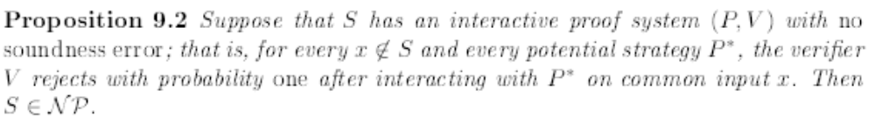
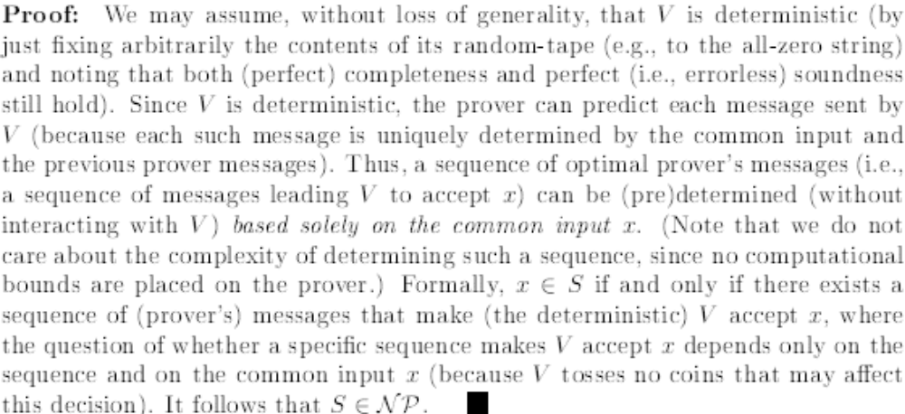

Slide 19
Graph Isomorphism
graphs G₀ = (V, E₀) and G₁ = (V, E₁) are isomorphic (G₀ ≅ G₁) if exists a permutation π:V → V for which
(x, y) ∈ E₀ ⇔ (π(x), π(y)) ∈ E₁
1
1
1
2
4
3
3
4
2
3
2
4

Slide 20
Graph Isomorphism
GI = {(G₀, G₁) : G₀ ≅ G₁ }
  in NP
  not known to be in P, or NP-complete
GNI = complement of GI
  not known to be in NP
Theorem (GMW): GNI ∈ IP
  indication IP may be more powerful than NP

Slide 21
GNI in IP
interactive proof system for GNI:
input: (G₀, G₁)
Prover
Verifier
H = π(G_{c})
flip coin c ∈ {0,1}; pick random π
if H ≅ G₀ r = 0, else r = 1
r
accept iff r = c

Slide 22
GNI in IP
completeness:
  if G₀ not isomorphic to G₁ then H is isomorphic to exactly one of (G₀, G₁)
  prover will choose correct r
soundness:
  if G₀ ≅ G₁ then prover sees same distribution on H for c = 0, c = 1
  no information on c ⇒ any prover P* can succeed with probability at most 1/2

Slide 23
The power of IP
GNI ∈ IP suggests IP more powerful than NP, since we don’t know how to show GNI in NP
GNI in coNP
任一co-NP完备问题都属于IP
（针对co-NP完全的不可满足CNF范式集合构造一个交互式证明系统）
Theorem : coNP ⊂ IP

Slide 24
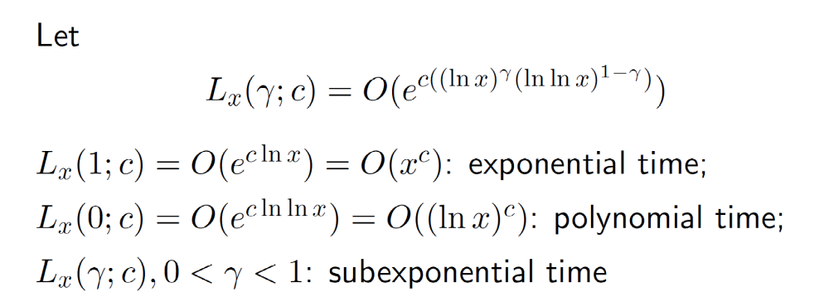
Laszlo Babai ，Graph Isomorphism in Quasipolynomial Time， A preprint is at: http://arxiv.org/pdf/1512.03547v1.pdf

Slide 25
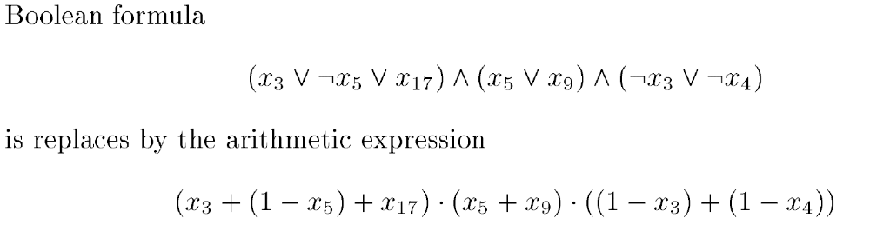
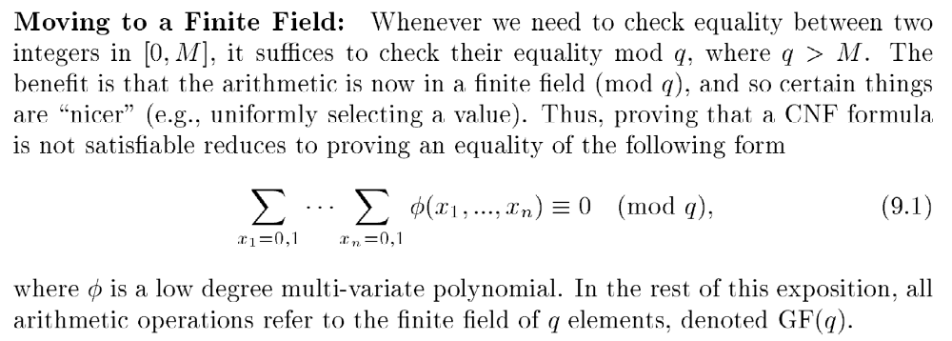
Co-SAT ⊂ IP
Arithmetization of Boolean(CNF) formulae

Slide 26
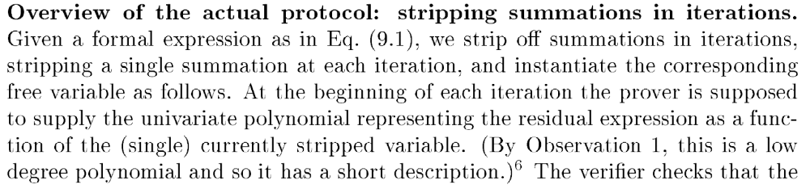
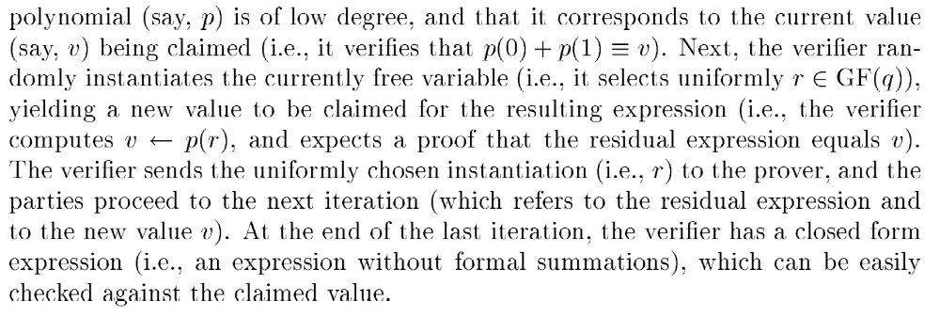

Slide 27
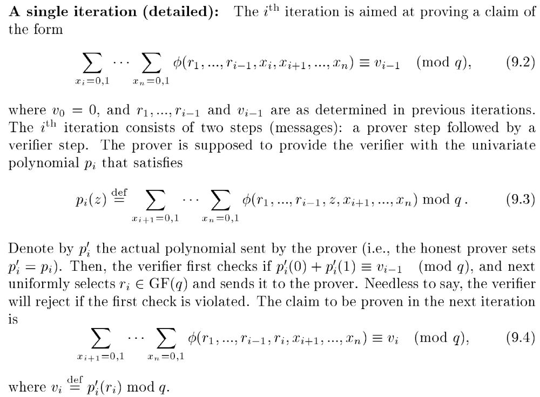

Slide 28
IP = PSPACE
Theorem: (Shamir) IP = PSPACE
  Note: IP ⊂ PSPACE
    enumerate all possible interactions, explicitly calculate acceptance probability
interaction extremely powerful !
An implication: you can interact with master player of Generalized Geography and determine if she can win from the current configuration even if you do not have the power to compute optimal moves!

Slide 29
IP = PSPACE
首先证明coNP ⊂ IP
将这一证明系统扩展到对PSPACE完全的不可满足量化布尔公式集合的证明，这就证明了PSPACE ⊂ IP
再借助 IP⊂ PSPACE

Slide 30
Witness Protection Programs
A witness indistinguishable proof system for X∈S
Prover P ⇔ Verifier V
Completeness: if prover P has witness W - can construct effective proof that makes verifier V accept.
Soundness: if X∉S no prover P* can succeed with high probability to make verifier V accept.
Witness Indistinguishability: for every V* and any witnesses W₁ and W₂: distributions on transcripts are computationally indistinguishable.
  No polynomial time test can distinguish the two

Slide 31
Zero Knowledge
Each (cheating) verifier V* induces a distribution on transcripts on interaction with P
Zero-Knowledge Requirement: for all verifiers V* there exists a simulator S such that:
  simulator S is a pptm (does not get witness W)
  for all X∈S the distributions on transcripts that V* ’ induces and that S produces are computationally indistinguishable.
  Role of simulator similar to alternative adeversary in semantic security

Slide 32
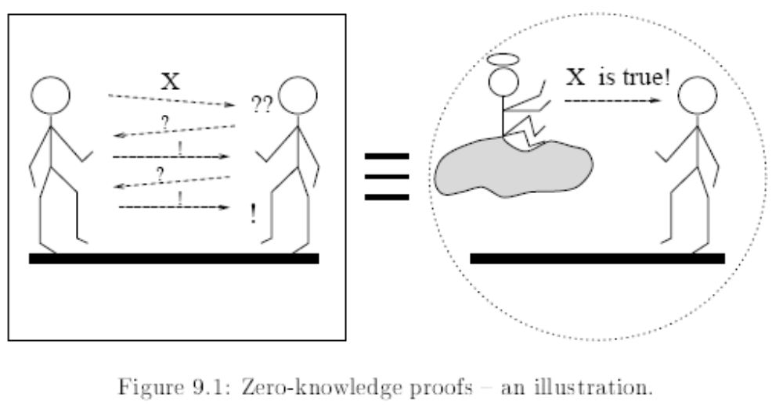

Slide 33
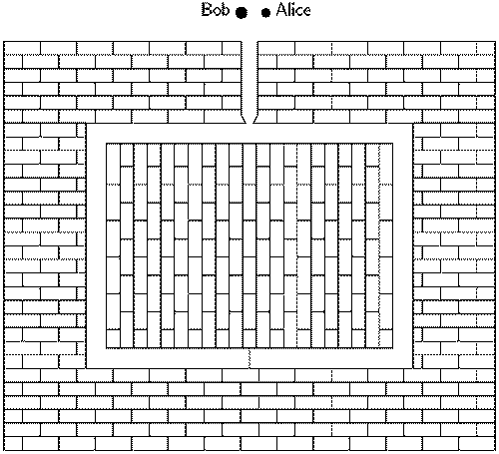
Illustrative example

Slide 34
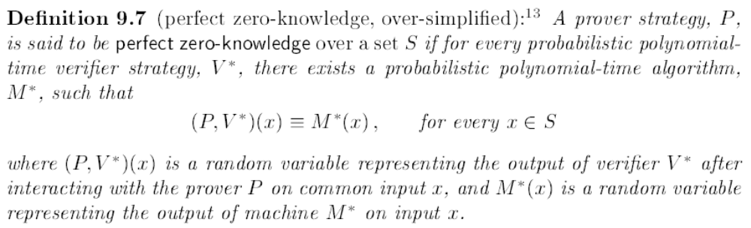
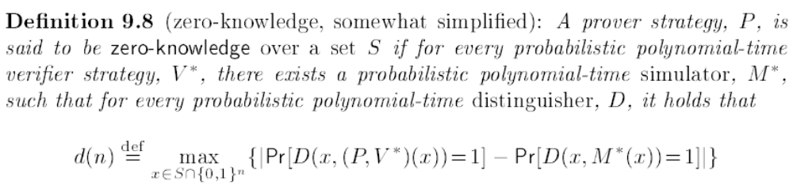

Slide 35
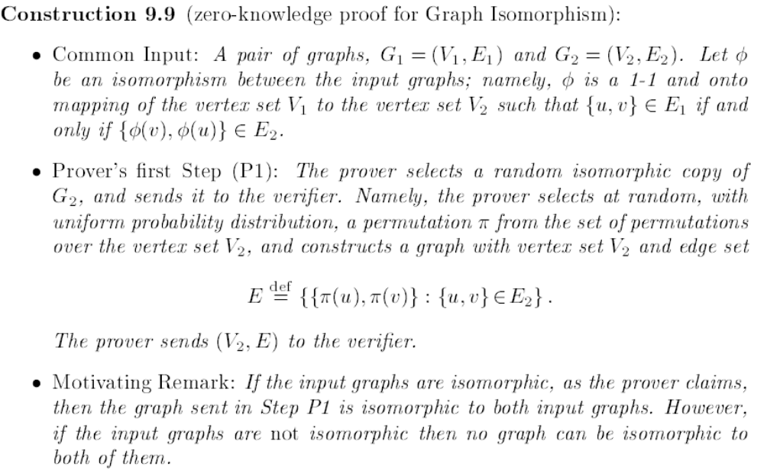

Slide 36
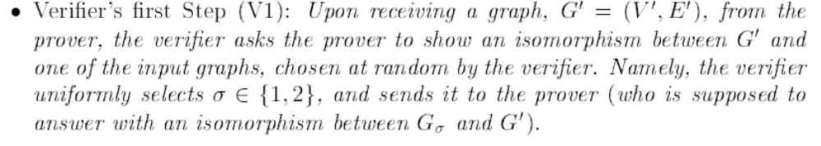
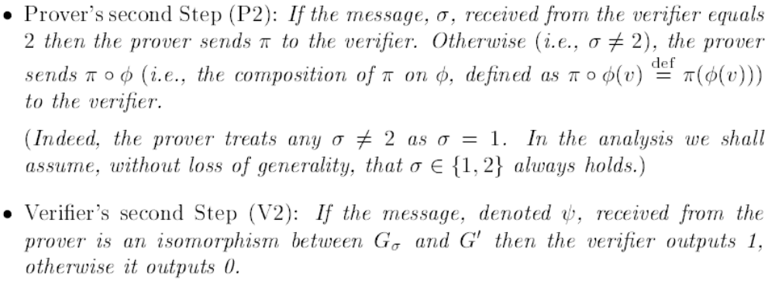

Slide 38
The Power of Zero Knowledge
Theorem: if one-way functions exist, then for any S in NP there exists a Zero-Knowledge Proof System for S.

Slide 39
zero-knowledge proof
A zero-knowledge proof must satisfy three properties:
Completeness: if the statement is true, the honest verifier (that is, one following the protocol properly) will be convinced of this fact by an honest prover.
Soundness: if the statement is false, no cheating prover can convince the honest verifier that it is true, except with some small probability.
Zero-knowledge: if the statement is true, no cheating verifier learns anything other than this fact. This is formalized by showing that every cheating verifier has some simulator that, given only the statement to be proven (and no access to the prover), can produce a transcript that "looks like" an interaction between the honest prover and the cheating verifier.

Slide 40

G3C
Common Input: A graph
1
1
2
Prover can color the graph using 3 colors.
2
3
4
3
4
Prover must keep the coloring secret.
5
5

Slide 41

G3C is in Zero-Knowledge
Construction (ZK IP for G3C):
Prover chooses a random color permutation.
1
1
1
2
2
2
3
3
4
3
4
Prover puts all the vertices` colors inside envelopes.
4
5
5
5
And sends them to the verifier.

Slide 42
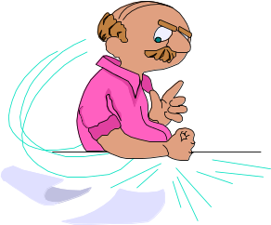
G3C is in ZK (cont.)
Verifier receives envelopes supposedly containing a legal 3-coloring of the graph
1
1
2
2
Verifier chooses an edge at random.
3
3
4
4
5
5
And asks Prover to open the 2 envelopes.

Slide 43
G3C is in ZK (cont.)
Prover opens the envelopes, revealing the colors.
1
1
2
2
Verifier accepts if the colors are different.
3
3
4
5

Slide 44
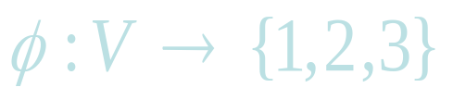
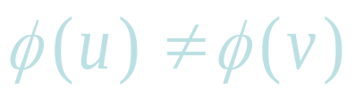
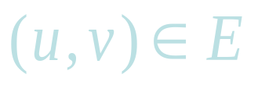
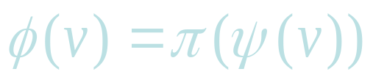
Formally,
G = (V,E) is 3-colorable if there exists a mapping so that for every .
Let ψ be a 3-coloring of G, and let π be a permutation over {1,2,3} chosen randomly.
Define a random 3-coloring.
Put each φ(v) in a box with v marked on it.
Send all the boxes to the verifier.

Slide 45
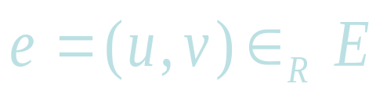
Formally, (cont.)
Verifier selects an edge at random
asking to inspect the colors.
Prover sends the keys to boxes u and v.
Verifier uses the keys to open the boxes.
If the Verifier finds 2 different colors from {1,2,3} - Accept.
Otherwise - Reject.

Slide 46
G3C (diagram)
1
2
n
φ(1)
φ(2)
φ(n)
^{P}
^{V}
^{P}
^{V}
Key_{u} , key_{v}
^{P}
^{V}

Slide 47
The construction is in ZK:
Completeness:
If G is 3-colorable and both P and V follow the rules, V accepts.
Soundness:
Suppose G is not 3-colorable and P* tries to cheat. Then at least one edge (u,v) will be monochromatic: φ (u) = φ (v).
V hence picks a bad edge with probability 1/|E|, which can be increased to 2/3 by repeating the protocol sufficiently many times.

Slide 48
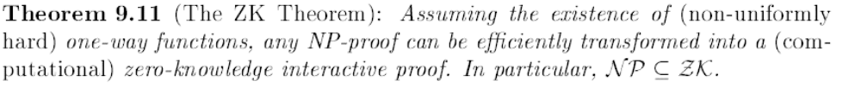


Slide 49
Protocol for quadratic residuosity
Given y, N where N=P*Q want to prove that y is a quadratic residue:
  there exist x such that x² = y mod N
Zero-knowledge protocol for Prover who knows x
Prover: choose random r ∈_{R} Z_{N}* and send z=r² mod N
Verifier: send b ∈_{R} {0,1}
Prover: send v = x^{b}r mod N
Verifier: check that v² = y^{b} z mod N

Slide 50
Analysis of Protocol
Completeness: perfect √
Soundness: if there exist v₀ and v₁ such that
  v₀² = y⁰ z mod N
  and
  v₁² = y z mod N
  then v₁/v₀ is square root of y.
  Probability of cheating is at most ½
Zero-knowledge – simulator for V*:
  guess b’ ∈_{R} {0,1} and select v ∈_{R} Z_{N}*
  Send z = v²/y^{b}’
  Obtain b∈{0,1} from V*
  If b’=b proceed as planned: send v
  Otherwise rewind V* and start from scratch
Also proof of knowledge

Slide 51
PCP
Probabilistically Checkable Proof (PCP) permits novel way of verifying proof:
  pick random local test
  query proof in specified k locations
  accept iff passes test
fancy name for a NP-hardness reduction

Slide 52
T
PCP Verifier
(probabilistic, errs with small probability,
reads few bits of proof)
Reads Theorem
2. Tosses coins
3. Reads few bits of proof
4. Accepts/Rejects.
010010100101010101010
V
HTHTTH
0
1
0
P
T
V
a
l
i
d
)
9
P
s
t
V
a
c
c
e
p
t
s
w
p
1
.
.
.
.
.
T
i
n
v
a
l
i
d
8
P
V
a
c
c
e
p
t
s
w
p
·
1
)
,
.
.
2
.

Slide 53
概率可验证证明系统
PCP是基于概率Oracle图灵机和交互证明系统的新的系统

Slide 54
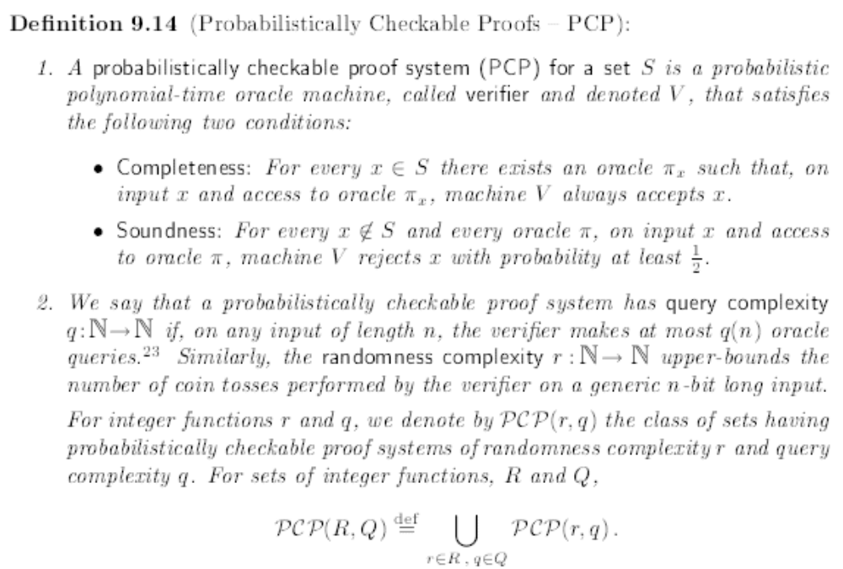

Slide 55
PCP
Two observations:
  PCP[O(1), poly n] = NP
  PCP[log n, O(1)] ⊂ NP
The PCP Theorem (AS, ALMSS):
PCP[log n, O(1)] = NP.

Slide 56
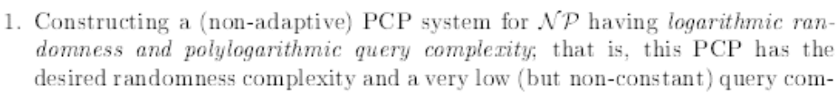
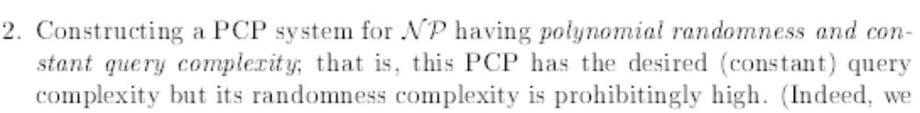
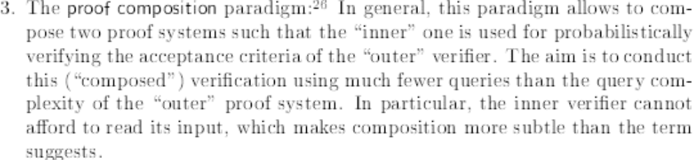
The PCP Theorem
Elements of proof:

Slide 57
Proof Composition (idea)
  NP ⊂ PCP[log n, polylog n] (“outer verifier”)
  NP ⊂ PCP[n³, 1] (“inner verifier”)
composition of verifiers:
  reformulate “outer” so that it uses O(log n) random bits to make 1 query to each of 3 provers
  replies r₁, r₂, r₃ have length polylog n
  Key: accept/reject decision computable from r₁, r₂, r₃ by small circuit C

Slide 58
Proof Composition (idea)
  NP ⊂ PCP[log n, polylog n] (“outer verifier”)
  NP ⊂ PCP[n³, 1] (“inner verifier”)
composition of verifiers (continued):
  final proof contains proof that C(r₁, r₂, r₃) = 1 for inner verifier’s use
  use inner verifier to verify that C(r₁,r₂,r₃) = 1
  O(log n)+polylog n randomness
  O(1) queries
  tricky issue: consistency

Slide 59
Proof Composition (idea)
NP ⊂ PCP[log n, O(1)] comes from
  repeated composition
  PCP[log n, polylog n] with PCP[log n, polylog n] yields
  PCP[log n, polyloglog n]
  PCP[log n, polyloglog n] with PCP[n³, 1] yields
  PCP[log n, 1]
many details omitted…

Slide 60
计算复杂性课程总结
计算任务和计算模型
时间复杂度
空间复杂度
随机性
交互证明

Slide 61
计算任务和计算模型
Search problem and Decision problem
Uniform Models
Turing machine and its variants
图灵机的定义及其工作原理
Non-uniform models
Circuits, Advice

Slide 62
时间复杂度
P, NP(两个定义及其等价性)
Polynomial-time Reductions
Self-reducing（定义及证明）
NPC（定义及证明）
coNP
P/poly
The polynomial-time hierarchy
DTIME(n), NTIME(n)

Slide 63
空间复杂度
L，NL
Dspace, Nspace, PSPACE
Savitch’s Theorem
Immerman-Szelepcsényi Theorem

Slide 64
随机性
BPP
RP, coRP
ZPP

Slide 65
交互式
IP
NP is in IP
CoNP is in IP
IP = PSPACE
ZKP
PCP

Slide 66
Course summary
Time and space L, P, PSPACE, EXP
Non-determinism NL, NP, coNP, NEXP
Non-uniformity P/poly
Randomness ZPP, RP, coRP, BPP
Alternation PH, PSPACE
Counting #P
Interaction IP, PCP[log n, 1]

Slide 67
The big picture
All classes on previous slide are probably distinct, except:
  P, ZPP, RP, coRP, BPP (probably all equal)
  L, RL (probably all equal; NL?)
  IP = PSPACE
  PCP[log n, 1] = NP
Only real separations we know separate classes delimiting same resource:
  e.g. L ≠ PSPACE, NP ≠ NEXP

Slide 68
The big picture
Important techniques/ideas:
  reductions and completeness
  self-reducibility
  Randomness
  Interactive
  others…

